Slide 1
Business Process and Functional Modeling Session 17
Course : COMP6056
Effective Period : September 2021

Slide 2
Sub Topics
Introduction
Business Process Identification using Use Case Diagram
Business process Modeling using Activity Diagram
Business Process Documentation: use case Description
Verifying and validating and functional Model
Applying the concepts
Data Flow Diagram

Slide 3
These slides have been adapted from: Alan Dennis, Barbara Haley Wixom, David Tegarden (2015). Systems Analysis and Design_ An Object-Oriented Approach with UML, 5th ed. ISBN: 978-1-118-80467-4 Chapter 4
Acknowledgement

Slide 4
Learning Objectives
At the end of this lecture, students are able to:
LO3: To analyze the requirement using Use Case and Activity Diagram

Slide 5
Introduction
All object-oriented systems development approaches are use-case driven, architecture-centric, and iterative and incremental.
A use case is a formal way of representing the way a business system interacts with its environment.
A use case is a high-level overview of the business processes in a business information system.
From an architecture-centric perspective, use-case modeling supports the creation of an external or functional view of a business process in that it shows how the users view the process rather than the internal mechanisms by which the process and supporting systems operate
A. Dennis et al.,(2015). Systems Analysis and Design An Object-Oriented Approach with UML, 5th ed. ISBN: 978-1-118-80467-4

Slide 6
Introduction
All object-oriented systems development approaches are developed in an incremental and iterative manner
Activity diagrams are typically used to augment our understanding of the business processes and our use-case model
An activity diagram can be used for any type of process-modeling activity
Activity diagrams and use cases are logical model that describe the business domain’s activities without suggesting how they are conducted
A. Dennis et al.,(2015). Systems Analysis and Design An Object-Oriented Approach with UML, 5th ed. ISBN: 978-1-118-80467-4

Slide 7
Introduction
First we describe business process identification using use cases and use-case diagrams.
Second, we describe business process modeling with activity diagrams.
Third, we describe use-case descriptions, their elements, and a set of guidelines for creating them.
Fourth, we describe the process of verification and validation of the business process and functional models.
A. Dennis et al.,(2015). Systems Analysis and Design An Object-Oriented Approach with UML, 5th ed. ISBN: 978-1-118-80467-4

Slide 8
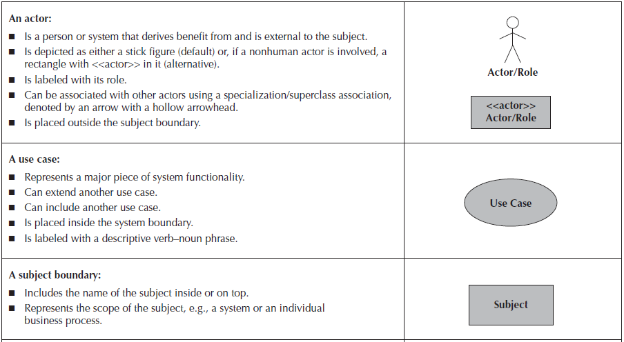
BUSINESS PROCESS IDENTIFICATION WITH USE CASES AND USE-CASE DIAGRAMS
Elements of Use-Case Diagrams
Gaddis, T., Starting Out With Programming Logic and Design, 5 ed, ISBN: 978-0-13-480115-5

Slide 9
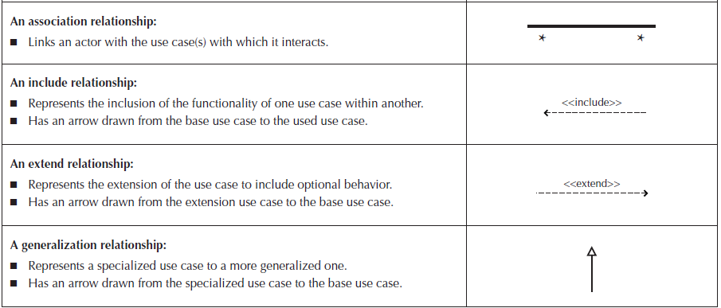
BUSINESS PROCESS IDENTIFICATION WITH USE CASES AND USE-CASE DIAGRAMS
Elements of Use-Case Diagrams
A. Dennis et al.,(2015). Systems Analysis and Design An Object-Oriented Approach with UML, 5th ed. ISBN: 978-1-118-80467-4

Slide 10
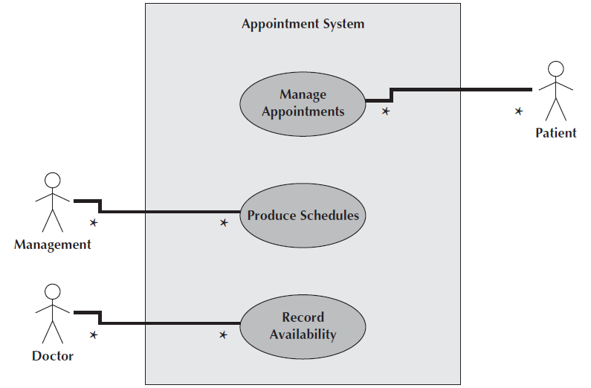
BUSINESS PROCESS IDENTIFICATION WITH USE CASES AND USE-CASE DIAGRAMS
Example: Use Case Diagram for Appointment System
A. Dennis et al.,(2015). Systems Analysis and Design An Object-Oriented Approach with UML, 5th ed. ISBN: 978-1-118-80467-4

Slide 11
BUSINESS PROCESS IDENTIFICATION WITH USE CASES AND USE-CASE DIAGRAMS
Association Use cases are connected to actors through association relationships.
The association typically represents two-way communication between the use case and the actor. If the communication is only one way, then a solid arrowhead can be used to designate the direction of the flow of information.
It is possible to represent the multiplicity of the association.
A. Dennis et al.,(2015). Systems Analysis and Design An Object-Oriented Approach with UML, 5th ed. ISBN: 978-1-118-80467-4

Slide 12
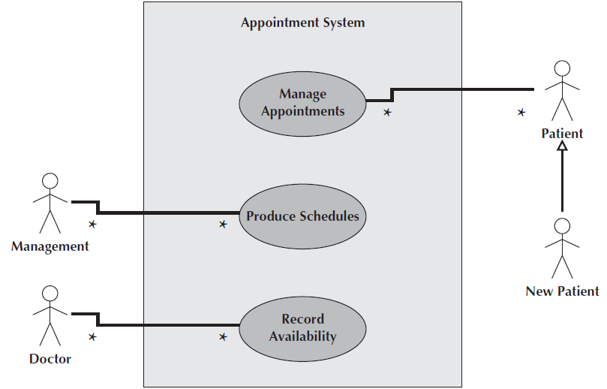
BUSINESS PROCESS IDENTIFICATION WITH USE CASES AND USE-CASE DIAGRAMS
Use Case with Specialized Actor
A. Dennis et al.,(2015). Systems Analysis and Design An Object-Oriented Approach with UML, 5th ed. ISBN: 978-1-118-80467-4

Slide 13
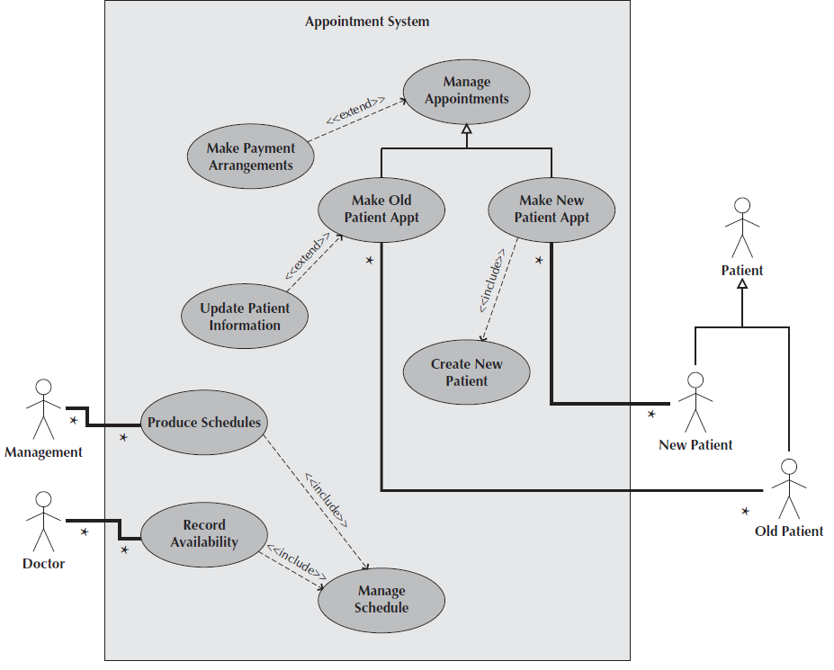
BUSINESS PROCESS IDENTIFICATION WITH USE CASES AND USE-CASE DIAGRAMS
Include and Extent Relationship
A. Dennis et al.,(2015). Systems Analysis and Design An Object-Oriented Approach with UML, 5th ed. ISBN: 978-1-118-80467-4

Slide 14
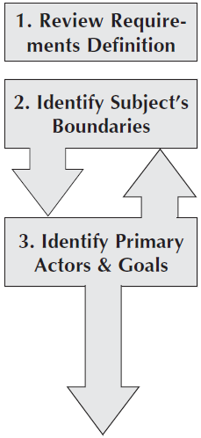
Identifying Use Case
Review the requirements definition. This helps the analyst to get a complete overview of the underlying business process being modeled.
Identify the subject’s boundaries. This helps the analyst to identify the scope of the system.
Identify the primary actors and their goals. The primary actors involved with the system come from a list of stakeholders and users. The goals represent the functionality that the system must provide the actor for the system to be a success.

Slide 15
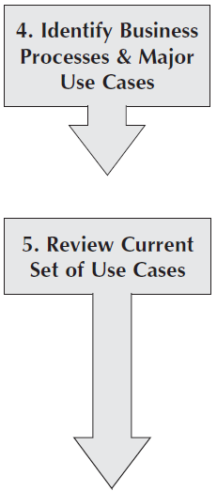
Identifying Use Case
Identify the business processes and major use cases. Identifying only the major use cases at this time prevents the users and analysts from forgetting key business processes and helps the users explain the overall set of business processes for which they are responsible.
Review the current set of use cases. It may be necessary to split some of them into multiple use cases or merge some of them into a single use case
A. Dennis et al.,(2015). Systems Analysis and Design An Object-Oriented Approach with UML, 5th ed. ISBN: 978-1-118-80467-4

Slide 16
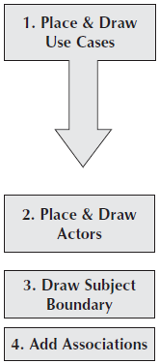
Creating Use Case Diagram
Place and draw the use cases on the diagram. These are taken directly from the major use cases previously identified. Special use-case associations (include, extend, or generalization) are also added to the model at this point.
Actors are placed and drawn on the diagram. To minimize the number of lines that cross on the diagram, the actors should be placed near the use cases with which they are associated.
Subject boundary is drawn.
Add associations by drawing lines to connect the actors to the use cases with which they interact

Slide 17
BUSINESS PROCESS DOCUMENTATION WITH USE CASES AND USE-CASE DESCRIPTIONS
Types of Use Cases
Overview Use Case
Created very early in the process of understanding the system requirements, and they document only basic information about the use case, such as its name; ID number; primary actor; type; a brief description; and the relationships among the actors, actors and use cases, and use cases
Detail use case
Contains all the information needed for the use case.
Essential Use Case
Describes only the minimum essential issues necessary to understand the required functionality
Real use case
Describes a specific set of steps
A. Dennis et al.,(2015). Systems Analysis and Design An Object-Oriented Approach with UML, 5th ed. ISBN: 978-1-118-80467-4

Slide 18
BUSINESS PROCESS DOCUMENTATION WITH USE CASES AND USE-CASE DESCRIPTIONS
Elements of a Use Case Description
Use Case Name
Actors
Overview Information
Stakeholders
Trigger
Relationships
Normal Flow of Events
Sub Flow
Alternative/Exceptions
A. Dennis et al.,(2015). Systems Analysis and Design An Object-Oriented Approach with UML, 5th ed. ISBN: 978-1-118-80467-4

Slide 19
Guidelines for Creating Use-Case Descriptions
Write each individual step in the form subject–verb–direct object and, optionally, preposition–indirect object
Make clear who or what is the initiator of the action and who or what is the receiver of the action in each step
Write the step from the perspective of an independent observer
Write each step at the same level of abstraction
Ensure that the use case contains a sensible set of actions. Each use case should represent a transaction
1. The primary actor initiates the execution of the use case by sending a request (and possibly data) to the system.
2. The system ensures that the request (and data) is valid.
3. The system processes the request (and data) and possibly changes its own internal state.
4. The system sends the primary actor the result of the processing
A. Dennis et al.,(2015). Systems Analysis and Design An Object-Oriented Approach with UML, 5th ed. ISBN: 978-1-118-80467-4

Slide 20
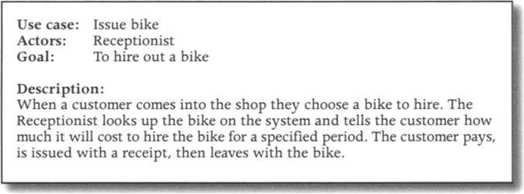
Use case descriptions
High Level Description:

Slide 21
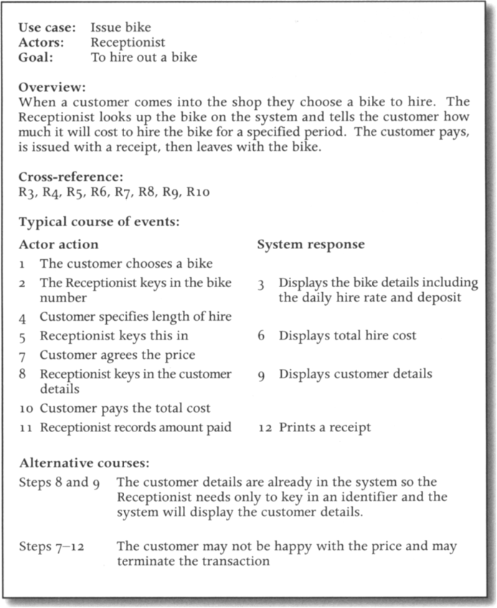
Use case descriptions
Expanded Description

Slide 22
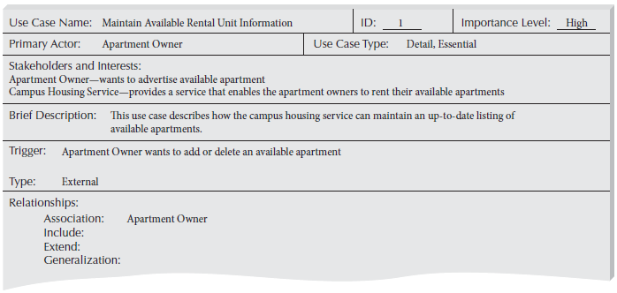
Guidelines for Creating Use-Case Descriptions
Expanded Description
A. Dennis et al.,(2015). Systems Analysis and Design An Object-Oriented Approach with UML, 5th ed. ISBN: 978-1-118-80467-4

Slide 23
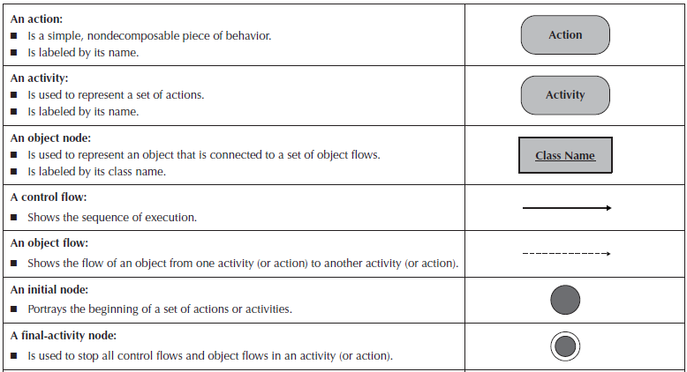
Elements of Activity Diagram
A. Dennis et al.,(2015). Systems Analysis and Design An Object-Oriented Approach with UML, 5th ed. ISBN: 978-1-118-80467-4

Slide 24
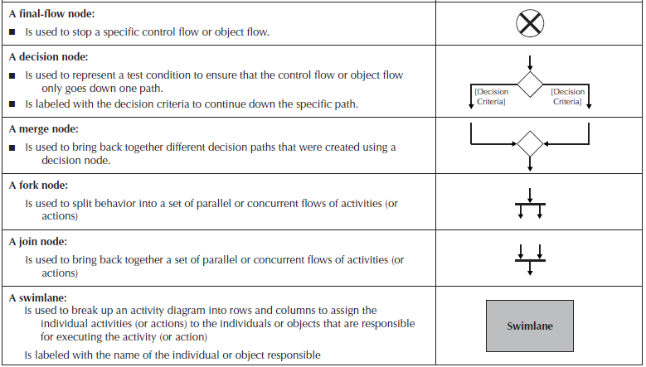
Elements of Activity Diagram
A. Dennis et al.,(2015). Systems Analysis and Design An Object-Oriented Approach with UML, 5th ed. ISBN: 978-1-118-80467-4

Slide 25
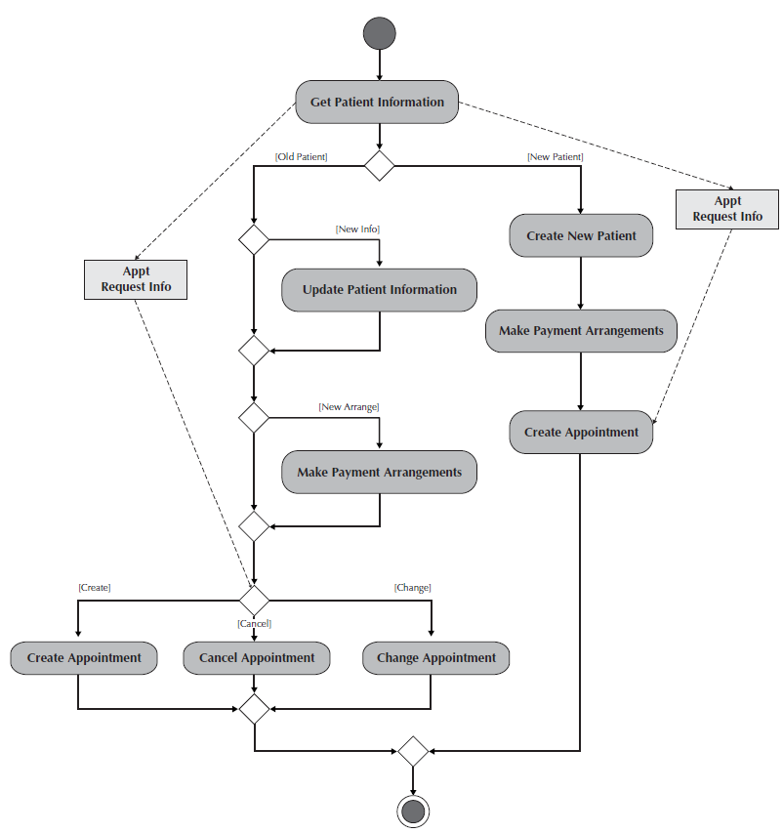
Elements of Activity Diagram
Activity Diagram for the Manage Appointments Use Case
A. Dennis et al.,(2015). Systems Analysis and Design An Object-Oriented Approach with UML, 5th ed. ISBN: 978-1-118-80467-4

Slide 26
Guideline for Creating Activity Diagram
Because an activity diagram can be used to model any kind of process, you should set the context or scope of the activity being modeled.
Once you have determined the scope, you should give the diagram an appropriate title.
■ You must identify the activities, control flows, and object flows that occur between the activities.
■ You should identify any decisions that are part of the process being modeled.
■ You should attempt to identify any prospects for parallelism in the process.
■ You should draw the activity diagram.
A. Dennis et al.,(2015). Systems Analysis and Design An Object-Oriented Approach with UML, 5th ed. ISBN: 978-1-118-80467-4

Slide 27
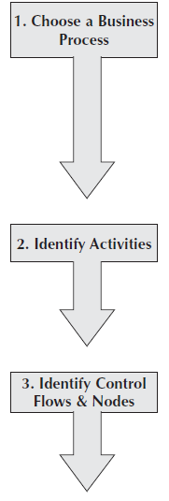
Creating Activity Diagram
Choose a business process that was previously identified to model. To do this, you should review the requirements definition and the use-case diagram created to represent the requirements.
Identify the set of activities necessary to support the business process.
Identify the control flows and nodes necessary to document the logic of the business process.

Slide 28
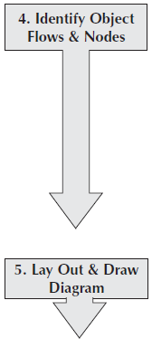
Creating Activity Diagram
Identify the object flows and nodes necessary to support the logic of the business process.
Lay out and draw the activity diagram to document the business process

Slide 29
Example
Simple activity diagram for ‘getCharge()’ operation

Slide 30
Modeling alternative courses of action
The activity diagrams can model different possible courses of action and conditions which determine which course is taken
As in state diagrams, it is essential that every guard evaluates to true or false.
Example : activity diagram for the ‘issue bike’ use case, showing alternative actions

Slide 31
Modeling iteration of activities
Activity diagram can also model iteration where one or more activities need to be repeated

Slide 32
Modeling activities that are carried out in parallel
Activity diagram also illustrate activities that can be performed in parallel
Example : activity diagram for the “Handle bike return’ use case, showing parallel activities

Slide 33
Swimlanes
The information about the object that responsible can be added to this diagram by dividing diagram into vertical zones known as swimlanes
Example : modified activity diagram for the ‘Handle bike return’ use case, showing responsibilities for different activities through the addition of swimlanes

Slide 35
VERIFYING AND VALIDATING
Walkthrough
A walkthrough is essentially a peer review of a product
A walkthrough uncovers errors or faults in the evolving specification
A walkthrough does not correct errors
Functional Model Verification and Validation
With three different representations for the functional model: activity diagrams, use-case descriptions, and use-case diagrams. In this section, we describe a set of rules to ensure that these three representations are consistent among themselves
A. Dennis et al.,(2015). Systems Analysis and Design An Object-Oriented Approach with UML, 5th ed. ISBN: 978-1-118-80467-4

Slide 36
Data Flow Diagram
Graphical representation of flow of data
DFD includes a mechanism to model the data flow
Supports decomposition
Characteristics:
(1) supporting the analysis and requirement stage of system design
(2) a diagramming technique with annotation;
(3) describing a network of activities/processes of the target system
(4) allowing for behaviors of parallel and asynchronous (5) stepwise refinement through hierarchical decomposition of processes.
Li Q., Chen YL. (2009) Data Flow Diagram. In: Modeling and Analysis of Enterprise and Information Systems. Springer, Berlin, Heidelberg

Slide 37
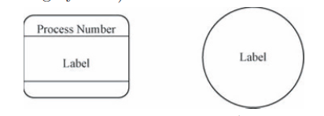
Data Flow Diagram
Symbols
Activity / process
External Entity
Data Flow
Data Store
Li Q., Chen YL. (2009) Data Flow Diagram. In: Modeling and Analysis of Enterprise and Information Systems. Springer, Berlin, Heidelberg

Slide 38
DFS Types
Context Diagram
Highest abstraction Level. Contains the scope of an organizational system that shows the system boundaries, external entities that interact with the system and the major information flows
Level 0
Represents a system’s major processes, data flows and data stores at a high level of detail
Level 1
The breakdown of Level 0 into more degtail, contains basic processes and sources of information.
Level 2
The breakdown of Level 1
Level 3, 4 etc.
Li Q., Chen YL. (2009) Data Flow Diagram. In: Modeling and Analysis of Enterprise and Information Systems. Springer, Berlin, Heidelberg

Slide 39
Example
Decomposition Framework
Li Q., Chen YL. (2009) Data Flow Diagram. In: Modeling and Analysis of Enterprise and Information Systems. Springer, Berlin, Heidelberg

Slide 40
Example
Context Diagram
Li Q., Chen YL. (2009) Data Flow Diagram. In: Modeling and Analysis of Enterprise and Information Systems. Springer, Berlin, Heidelberg

Slide 41
Example
Level 0
Li Q., Chen YL. (2009) Data Flow Diagram. In: Modeling and Analysis of Enterprise and Information Systems. Springer, Berlin, Heidelberg

Slide 42
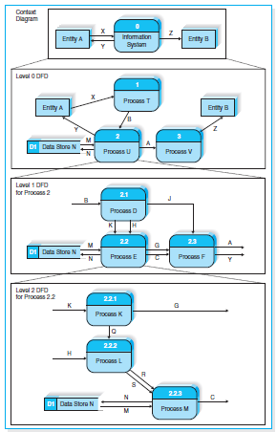
Using Data Flow Diagram to Define Business Processes

Slide 43
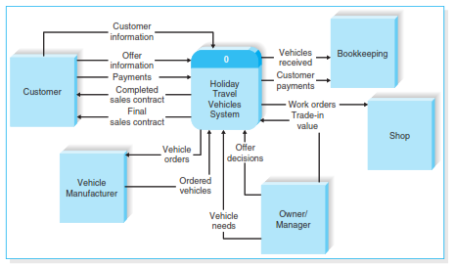
The context Diagram for ther Holiday Travel Vechicles syatem

Slide 44
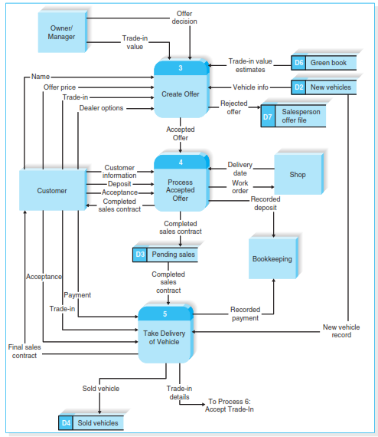
Holiday Travel Vehicles Partial Level 0 DFD

Slide 45
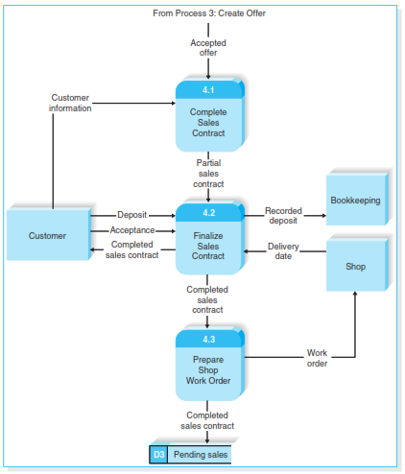
Level 1 DFD for Process Acepted Offer

Slide 46
References
Alan Dennis, Barbara Haley Wixom, David Tegarden (2015). Systems Analysis and Design_ An Object-Oriented Approach with UML, 5th ed. ISBN: 978-1-118-80467-4

